Slide 1


Slide 2


Biometric authentication system - IT4432E
2D-Face authorization
Members:
Chu Trung Anh 20225564
Bui Duy Anh 20225563
Pham Minh Tien 20225555
Supervisor:
Dr.Ngo Thanh Trung
Dr.Tran Nguyen Ngoc

Slide 3

Content
Introduction
Dataset
Our pipeline
Evaluation
Application
Future improvement
1

Slide 4

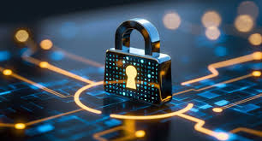
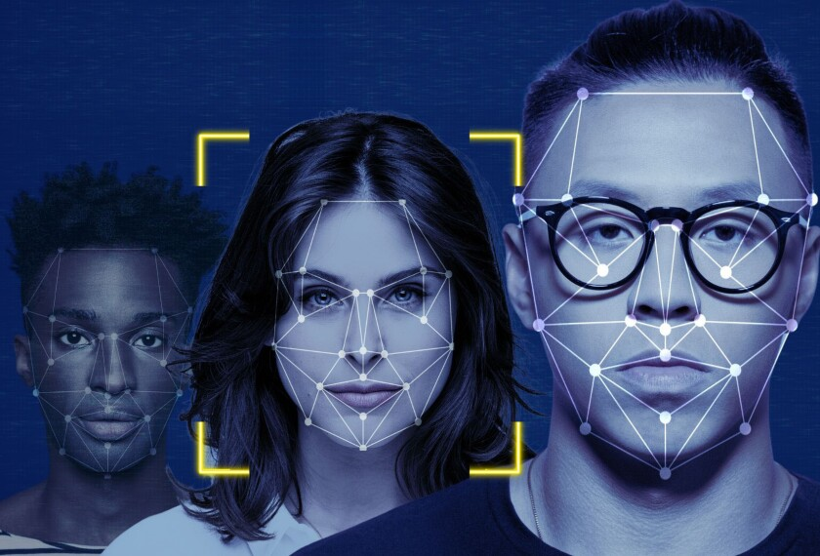
1. Introduction
In today’s world, strong security is more important than ever because traditional methods like passwords can be easily hacked
Pros:
Easier and fast way to verify access
Cons:
Can be inefficient due to noise or face spoofing
Facial authentication is an advanced solution that uses your unique facial features to verify your identity
2

Slide 5

1. Introduction
Reason why we choose this approach to the problem:
Easy to implemented in real-life situation
High universality and acceptability
Security enhancement
Broad application: in company, government, individual,...
Secure physical spaces( room, safe, building,...)
Secure digital system( laptop, phone,...)
3

Slide 6






1. Introduction
Dependenices
Backend:
GUI:
4

Slide 7




2. Dataset
Our project used three source of data:
lfw
bing_image_downloader
(RGB/IR)Webcam
https://vis-www.cs.umass.edu/lfw/
data
5

Slide 8



2. Dataset
Data structure:
data
person1
person2
person3
250x250 jpg format
6

Slide 9



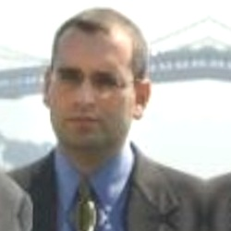


2. Dataset
Data argumentation:
. . .
low density
5774 folder
19270 images
~ 220MB
high density (>= 3 images in a folder)
5774 folder
30056images
~500 MB
original
horizontal flip
random brightness
7

Slide 10
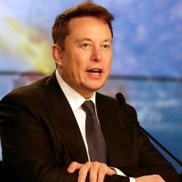
3. Pipeline
3.1 Train model
face detection
(using MTCNN)
data
8

Slide 11

3. Pipeline
3.1 Train model
face detection
(using MTCNN)
data
8

Slide 12
3. Pipeline
3.1 Train model
Extract face features with FaceNet (Pre-train)
[ 2.411e-02 -1.257e-02 . . . 1.449e-02]
face detection
(using MTCNN)
data
8

Slide 13
3. Pipeline
3.1 Train model
Extract face features with FaceNet (Pre-train)
Positive/Negative pairs
Train SVM
[ 2.411e-02 -1.257e-02 . . . 1.449e-02]
face detection
(using MTCNN)
data
8

Slide 14
3. Pipeline
3.1 Train model
Extract face features with FaceNet (Pre-train)
Train SVM
face detection
(using MTCNN)
data
Train Siamese Network + L1 distance layer
8

Slide 15

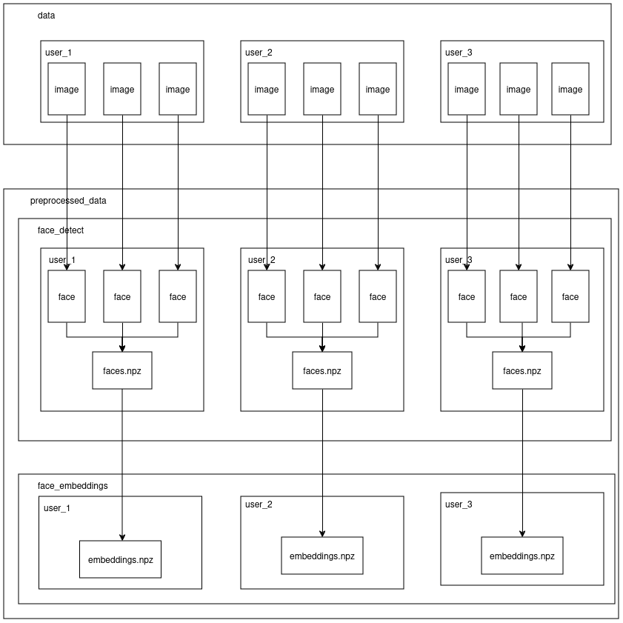
3. Pipeline
3.1.1 Train model – pipeline 1
9

Slide 16
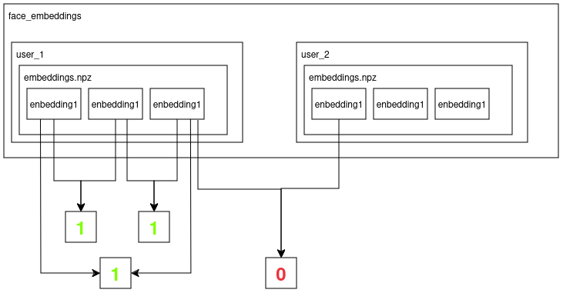
3. Pipeline
3.1.1 Train model – pipeline 1
10

Slide 17
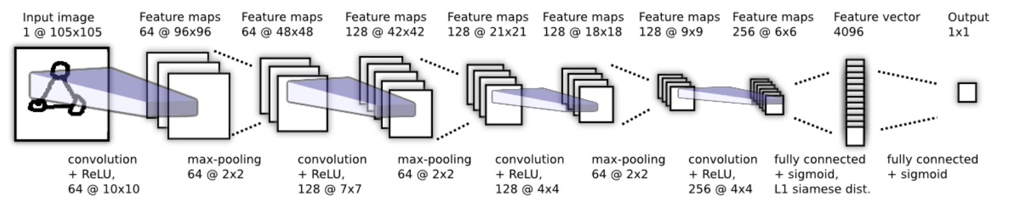
3. Pipeline
3.1.2 Train model – pipeline 2
Our network architecture:
https://www.cs.cmu.edu/~rsalakhu/papers/oneshot1.pdf
11

Slide 18
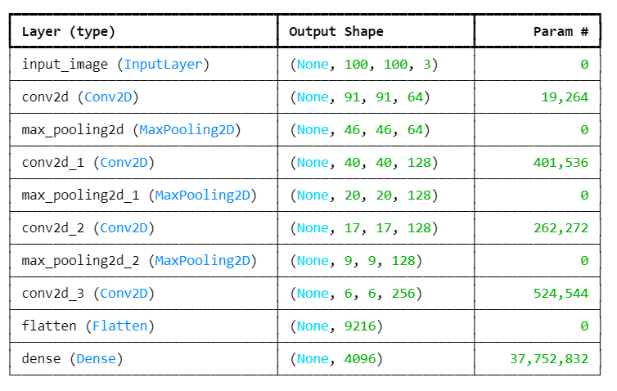
3. Pipeline
3.1.2 Train model – pipeline 2
Our network architecture:
12

Slide 19


3. Pipeline
3.1.2 Train model – pipeline 2
13

Slide 20
3. Pipeline
3.1.2 Train model – pipeline 2
Conv Network
Conv Network
13

Slide 21
3. Pipeline
3.1.2 Train model – pipeline 2
Conv Network
Encoding
Conv Network
13

Slide 22
3. Pipeline
3.1.2 Train model – pipeline 2
Conv Network
Encoding
Differencing layer
Manhattan distance (L1)
Conv Network
13

Slide 23
3. Pipeline
3.1.2 Train model – pipeline 2
Conv Network
Encoding
Differencing layer
Manhattan distance (L1)
Similarity score ><
Label
Conv Network
13

Slide 24
3. Pipeline
3.1.2 Train model – pipeline 2
Conv Network
Encoding
Differencing layer
Manhattan distance (L1)
Similarity score ><
Label
Conv Network
Back propagation
13

Slide 25
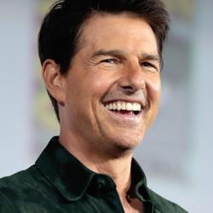
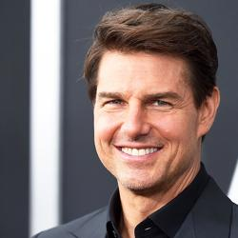
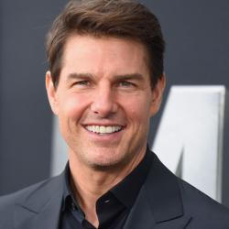
3. Pipeline
3.2 Enrollment/ Login
application_data/validation_images/tom cruise
. . .
User scan images
14

Slide 26


3. Pipeline
3.2 Enrollment/ Login
application_data/validation_images/tom cruise
. . .
. . .
User scan images
Face detection
14

Slide 27

3. Pipeline
3.2 Enrollment/ Login
application_data/validation_images/tom cruise
. . .
. . .
User scan images
Face detection
application_data/settings.json
Store available camera index on the system
14

Slide 28


3. Pipeline
3.2 Enrollment/ Login
application_data/validation_images/tom cruise
. . .
. . .
User scan images
Face detection
application_data/settings.json
Store available camera index on the system
[ 2.411e-02 -1.257e-02 . . . 1.449e-02]
14

Slide 29

3. Pipeline
3.2 Enrollment/ Login
application_data/validation_images/tom cruise
. . .
. . .
User scan images
Face detection
application_data/settings.json
Store available camera index on the system
Siamese.h5, svm.pkl
[ 2.411e-02 -1.257e-02 . . . 1.449e-02]
14

Slide 30


3. Pipeline
3.2 Enrollment/ Login
application_data/validation_images/tom cruise
. . .
. . .
User scan images
Face detection
application_data/settings.json
Store available camera index on the system
Siamese.h5, svm.pkl
[ 2.411e-02 -1.257e-02 . . . 1.449e-02]
14

Slide 31
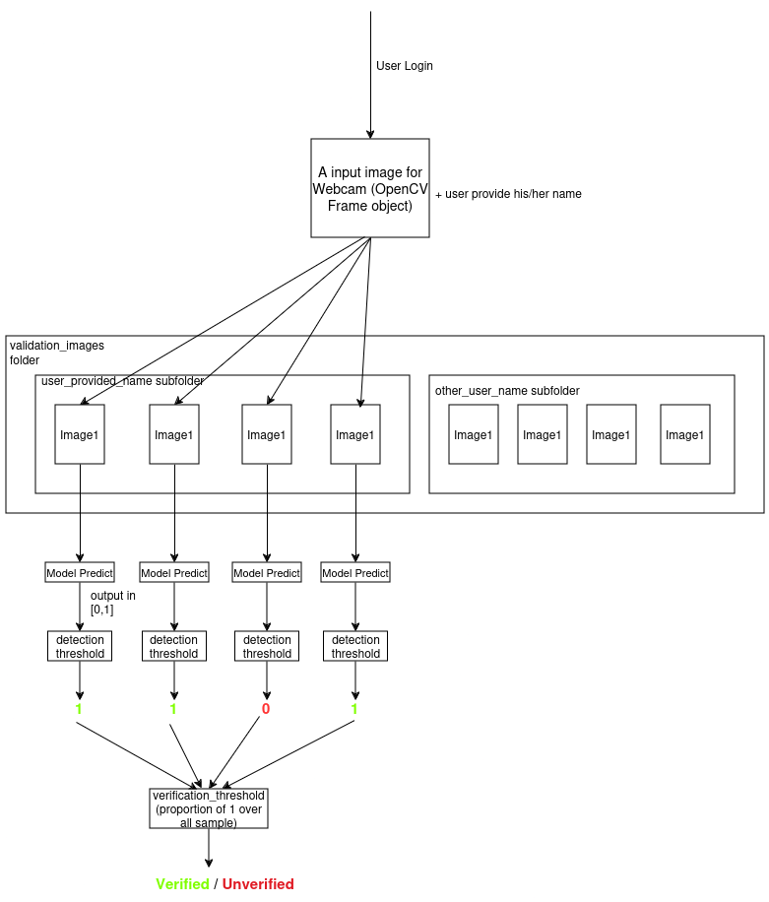
3. Pipeline
3.2 Enrollment/ Login
15

Slide 32
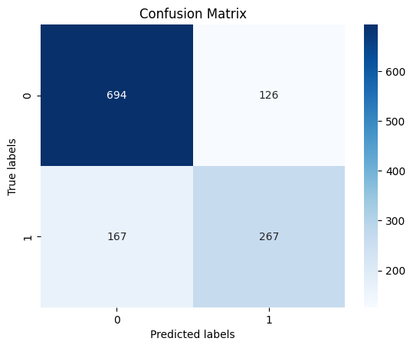
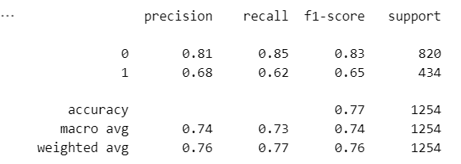
4. Evaluation
4.1 Pipeline 1
16

Slide 33
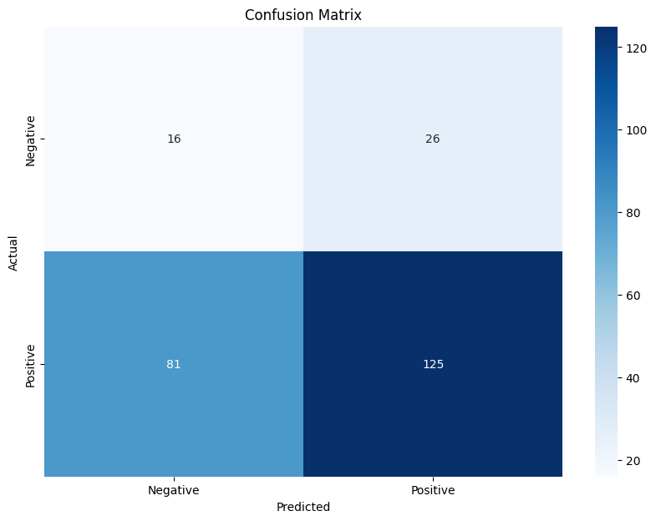
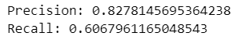
4. Evaluation
4.2 Pipeline 2
7

Slide 34
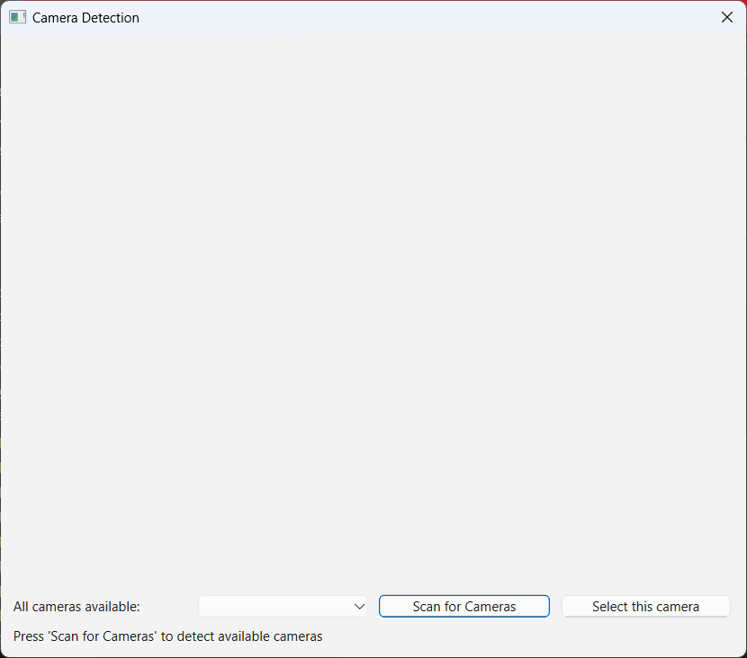
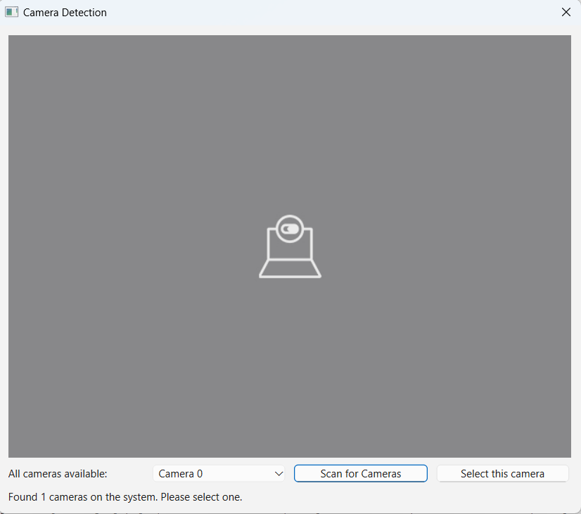
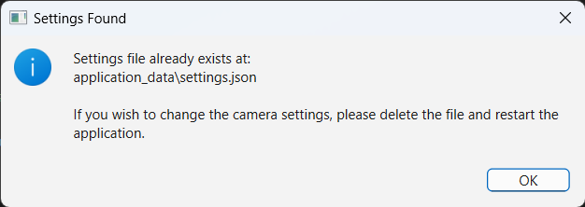
5. Demo
5.1 Camera detection
{"camera_list": [0,2], "preferred_camera": 0 }
If file settings. json already existed, no not camera detection window
17

Slide 35
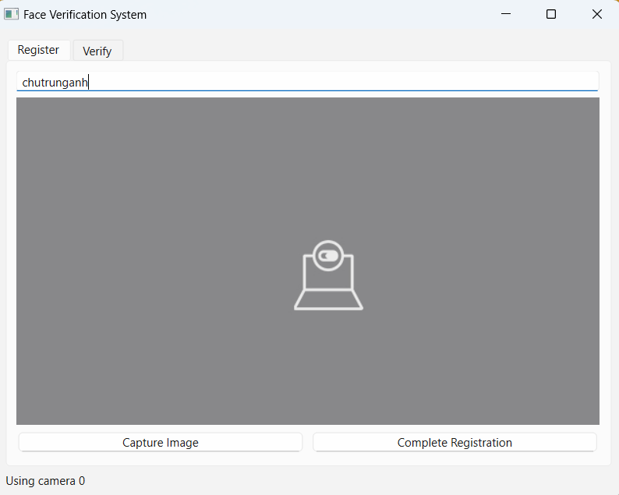
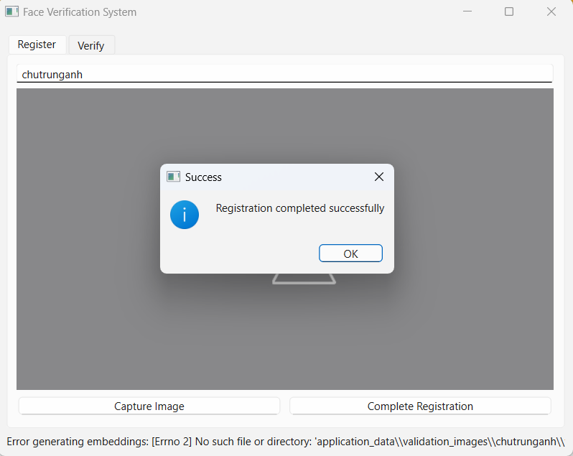
5. Demo
5.2 Enrollment
18

Slide 36
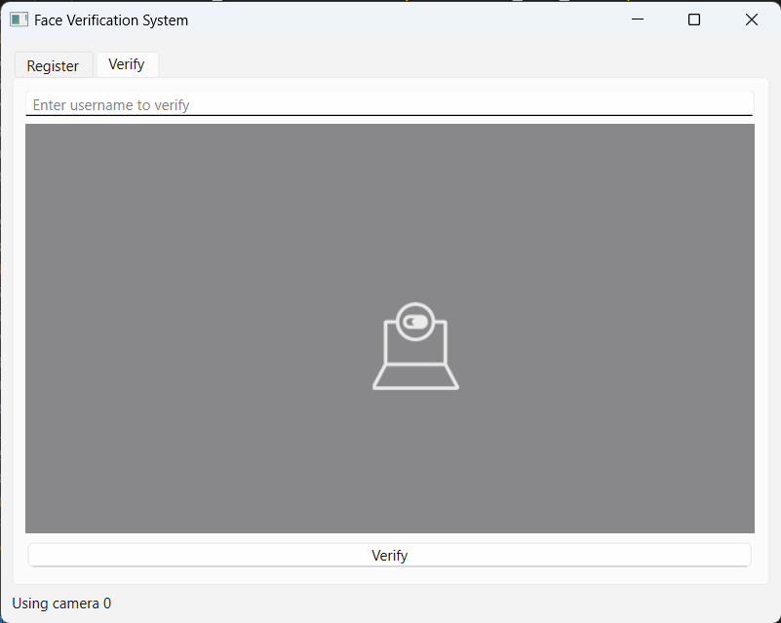
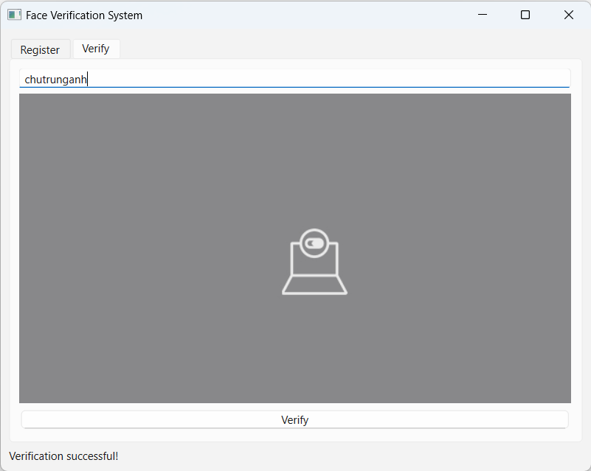
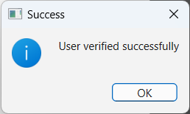
5. Demo
5.3 Login
19

Slide 37
6. Future Improvement
Trying other models to optimize the price per performance (time reduce; requires less powerful resources like camera, processor,...
Build a more user-friendly UI, easier to interact.
Deploy using docker, package in .exe, .deb for end-user
Collect more quality data to reduce biases
Handle variations like glass, mask, make-up,...
Quality control: Reject image that's too bright, dark , unable to recognize
Implement multi –instance verification of login images
Implement multi –thread for faster response time
​
20

Slide 38
Thank you for your listening !
21

